Slide 1
Data Science Final Project
Football rankings prediction
Presentation
Asaf Hermann
204803159

Slide 2

Table Of Content
01 | 02 | 03
Steps for execution | Data Acquistion | Pre-processing
04 EDA | 05 Models | 06 Prediction
07
Summary

Slide 3
Steps
The Steps which are performed are:
Data Acquistion
Data Pre-processing
EDA
ML Models
Model Scores

Slide 4

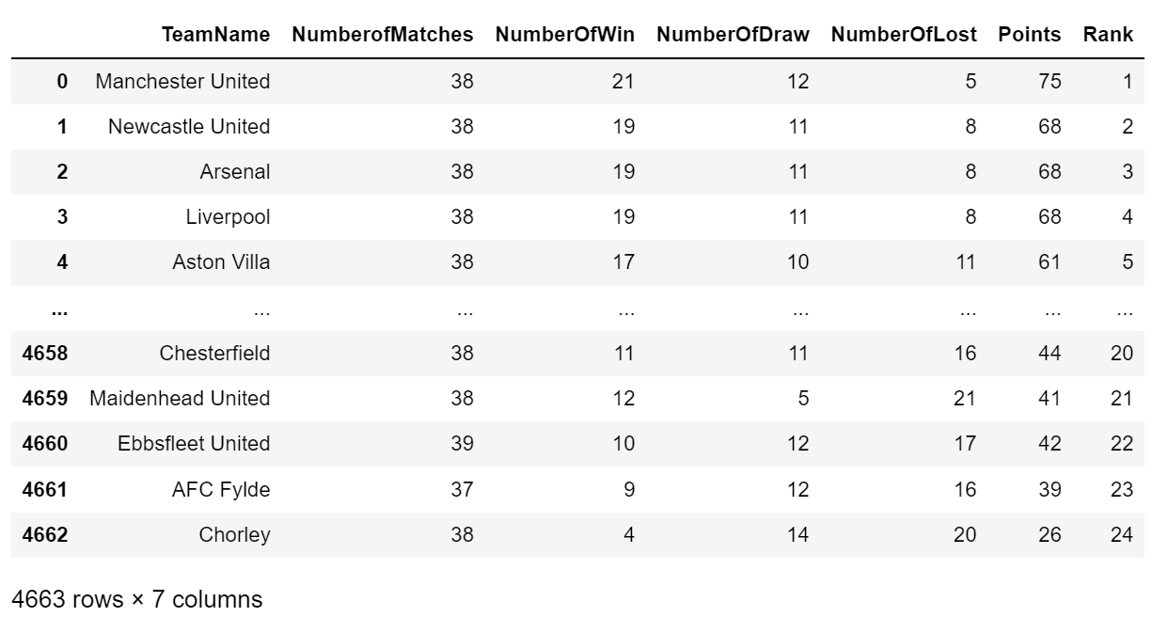
Data Acquistion
- Created lists that will store the data
- Used for loops to receive the data from the relevant URL's
- Crawled the data using BeautifulSoup (html.parser)
- Carried out and filtered the data to its relevant list using Python libraries
- Created data frames based on the lists

Slide 5
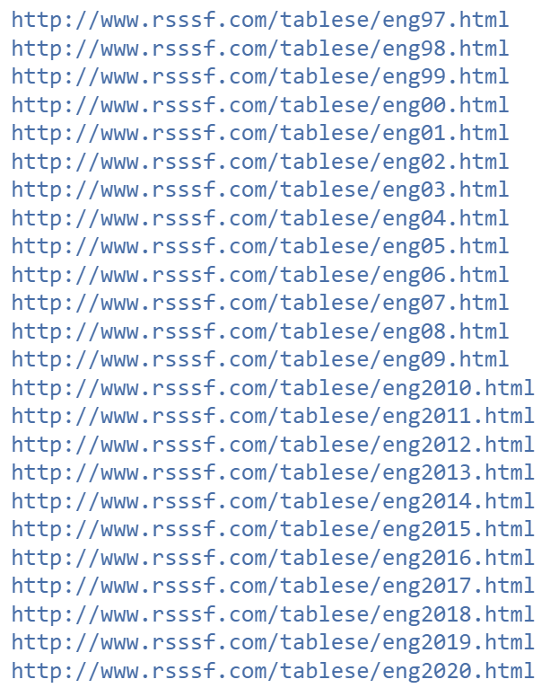
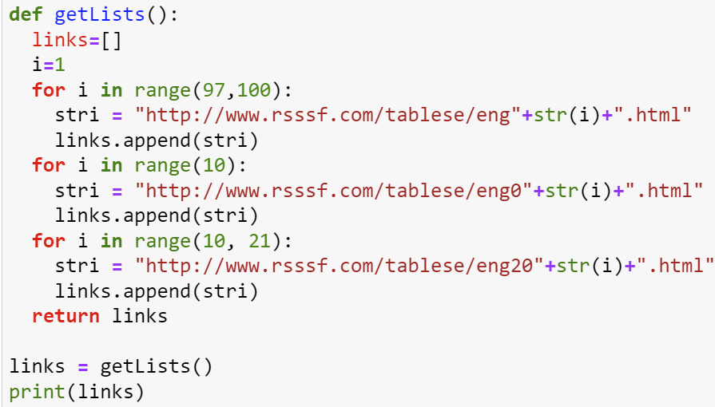
Crawling data using BeautifulSoup
URL's I crawled over
For loops that run on website URL's

Slide 6
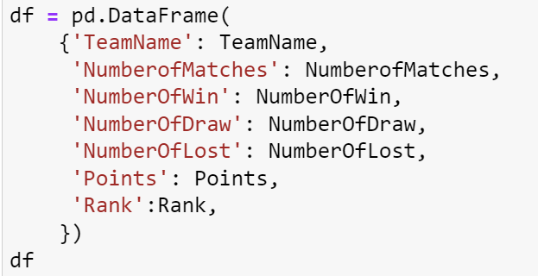
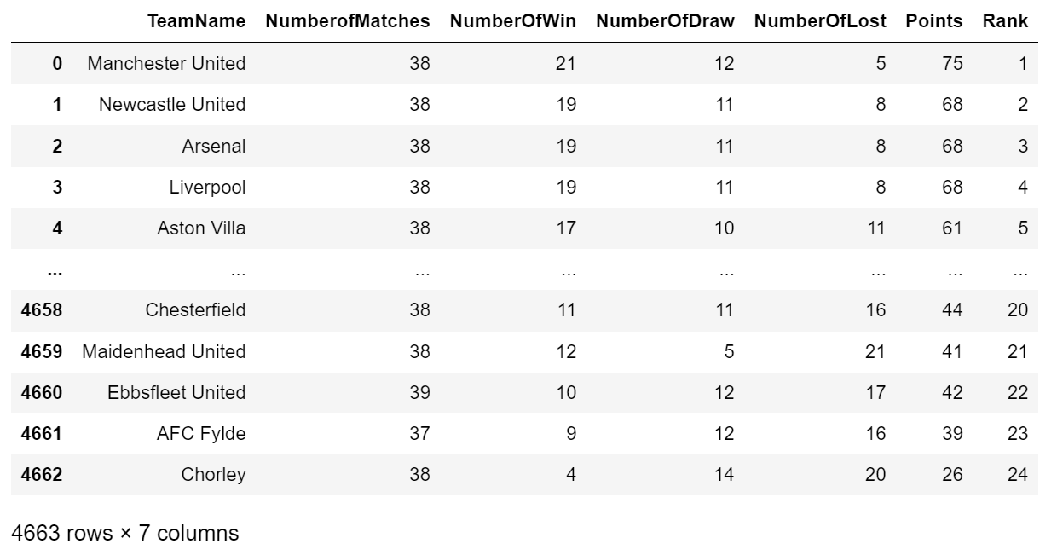
Creating a Data Frame using Pandas
Inserting data into DF My DF with all data since 1997

Slide 7
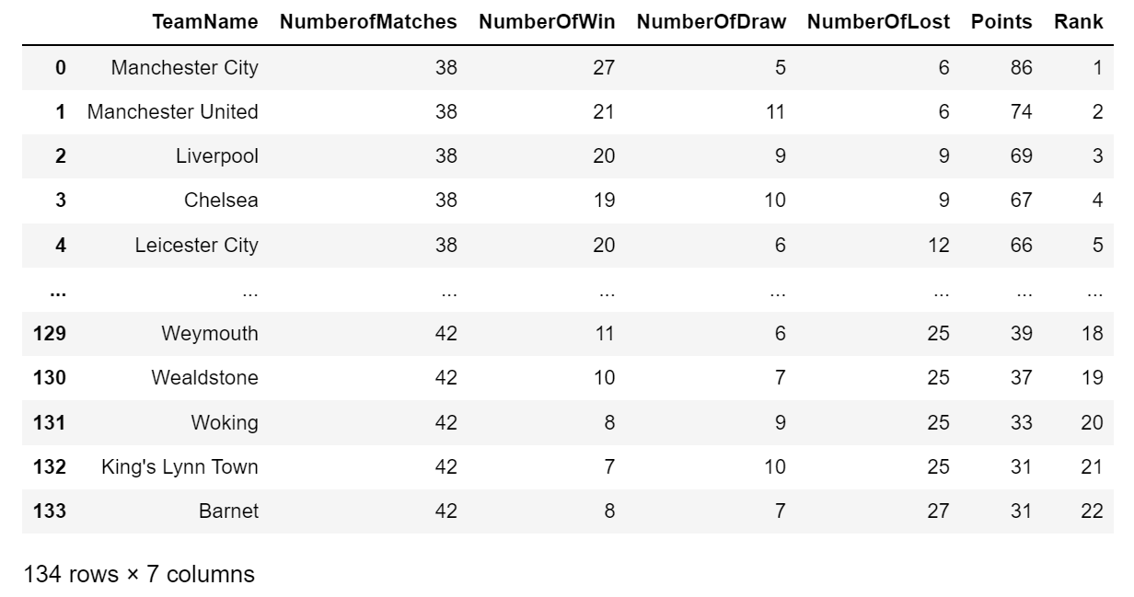
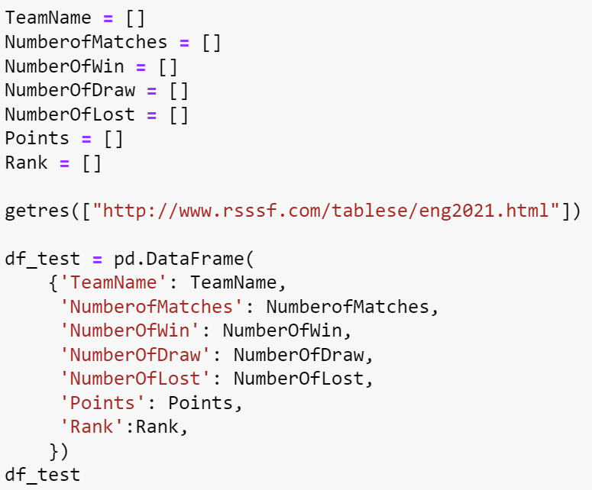
Creating a Test Data Frame
DF with data from 2021 season
לחץ כדי להוסיף טקסט
Predicted rank will be compared to this data

Slide 8
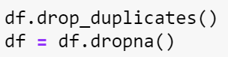
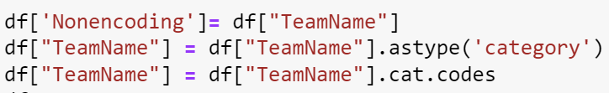
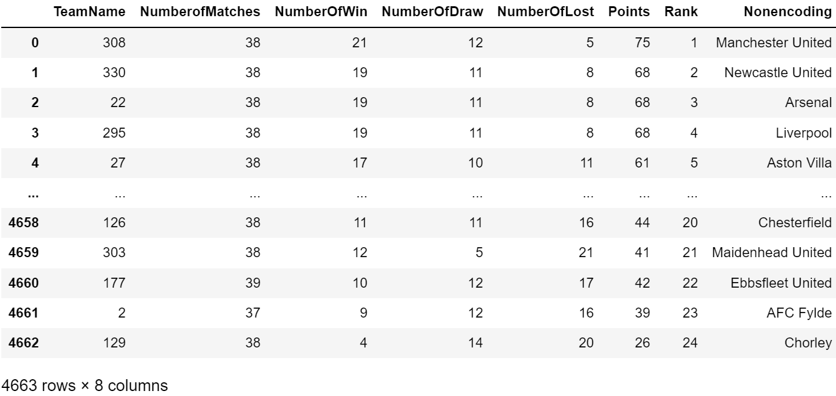
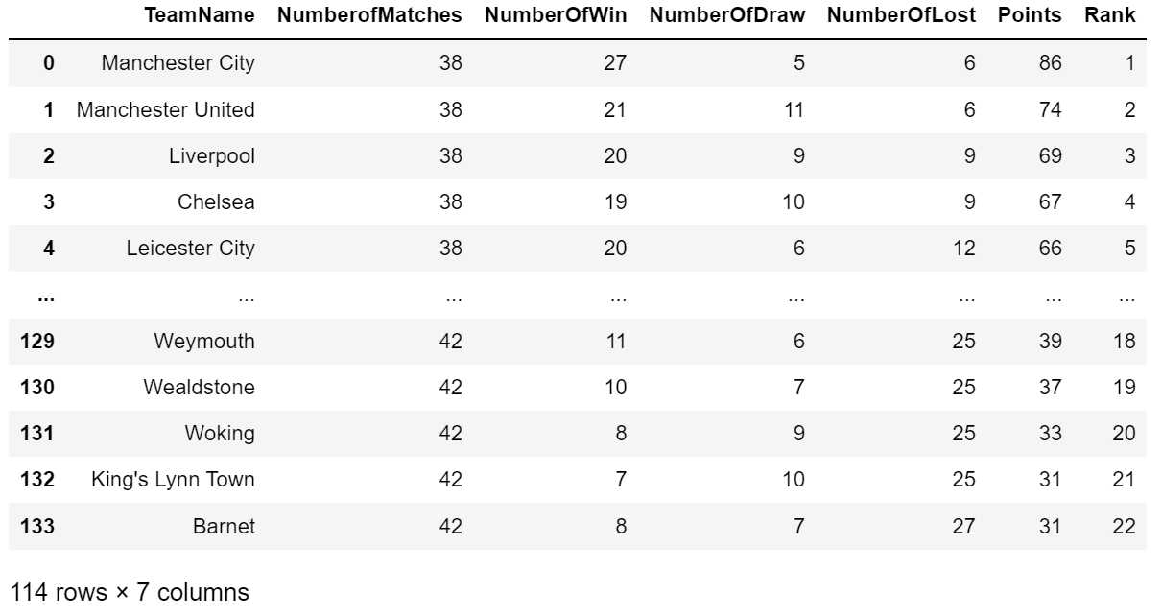
Data Pre-processing
- Removed NaN values - Removed duplicated values - Encoded TeamName variable to a number for future ML

Slide 9
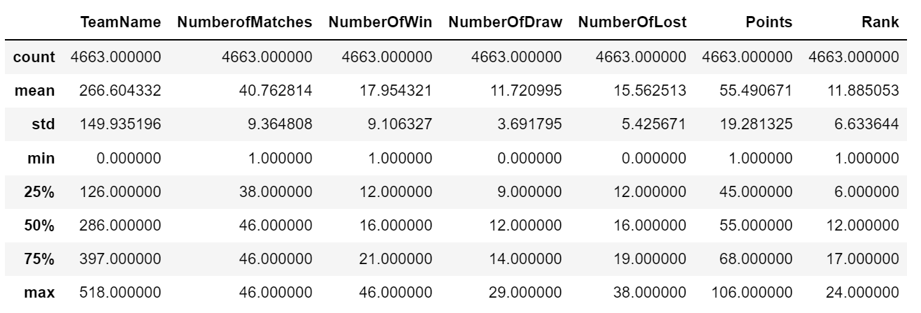
EDA
Statistical data graph

Slide 10
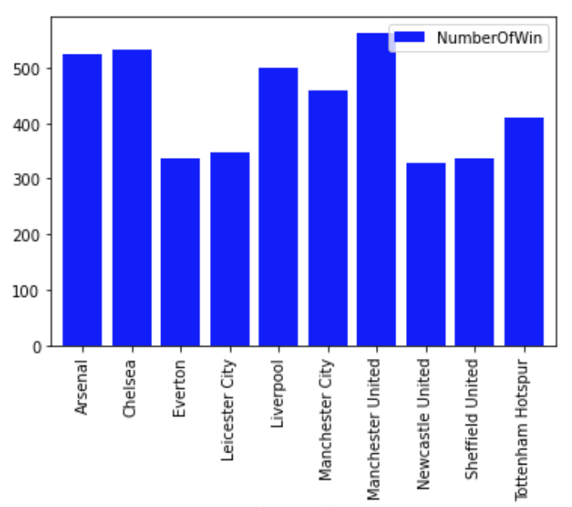
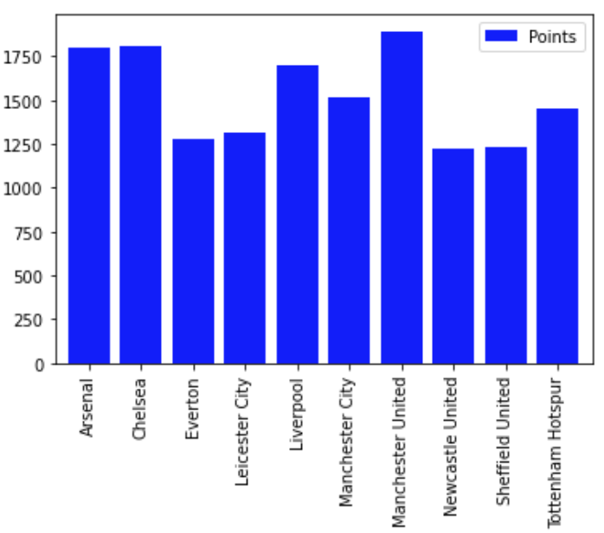
Data Analysis - Most Wins & most Points
Manchester United and Chelsea leads both categories

Slide 11
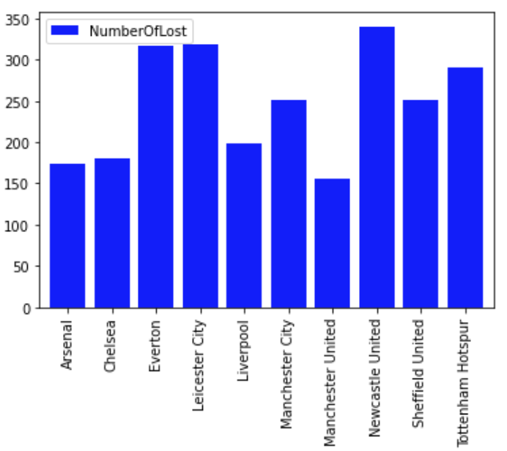
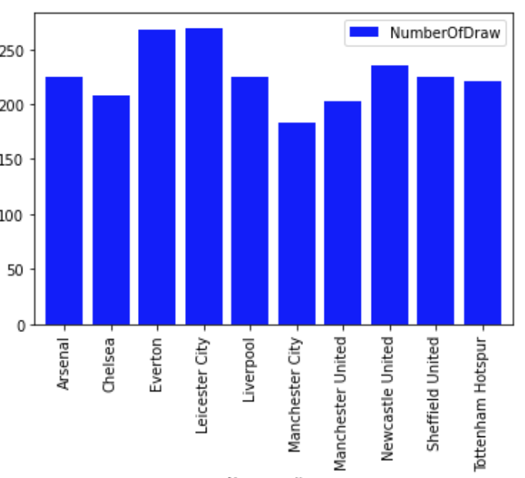
Data Analysis - Most Loses & most Draws
Newcastle and Leicter lost most games Leicter and Everton drew most games

Slide 12
ML Model (Decision Tree Model)
Research question
Can we predict in what position a team will finish the season, based on history data?

Slide 13
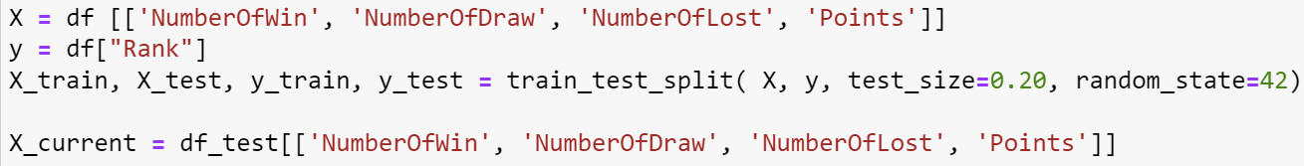
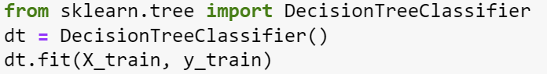
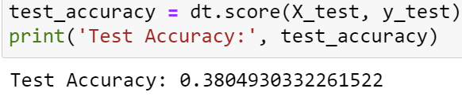
Train, test and predict
I splitted the data to train and test
Then I built the decision tree model
And calculated the prediction accuracy for tested dataset

Slide 14
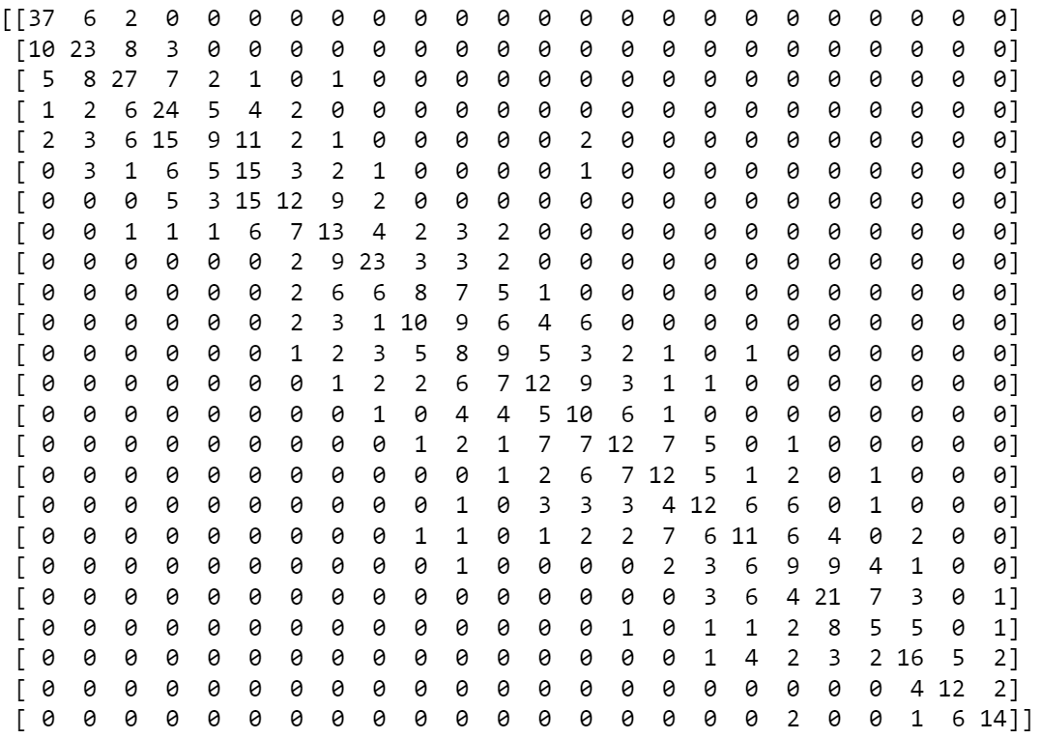
Confusion Matrix
We can see in the Confusion Matrix that the model was quiet accurate, even though it was also wrong few times

Slide 15
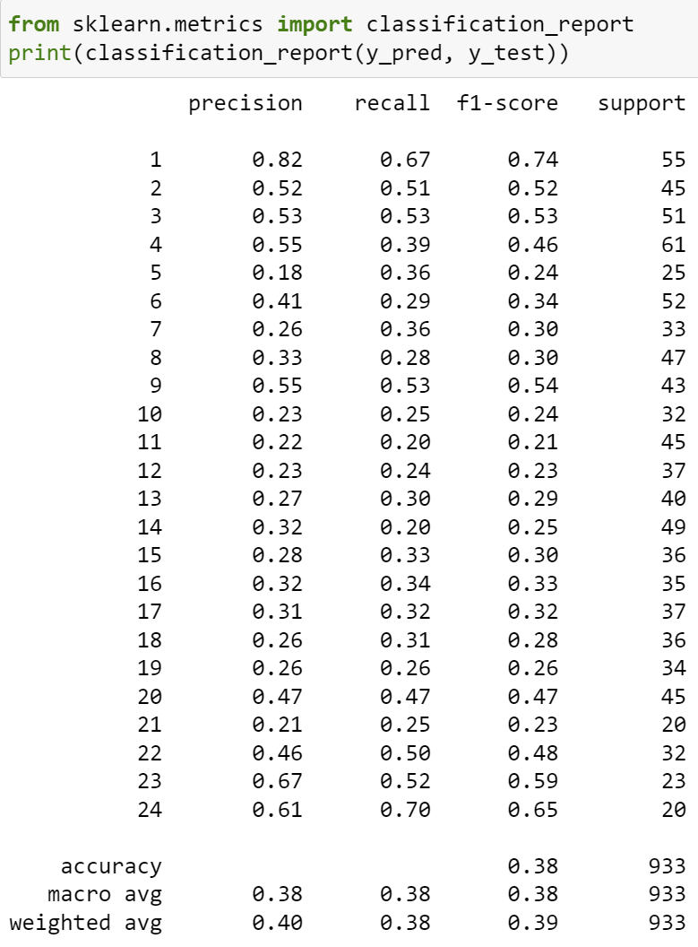
Classification Report
- Precision Rank 1 - 82%
- Recall Rank 1 - 67%
- Overall Accuracy - 39%
- Very hard to predict all teams

Slide 16
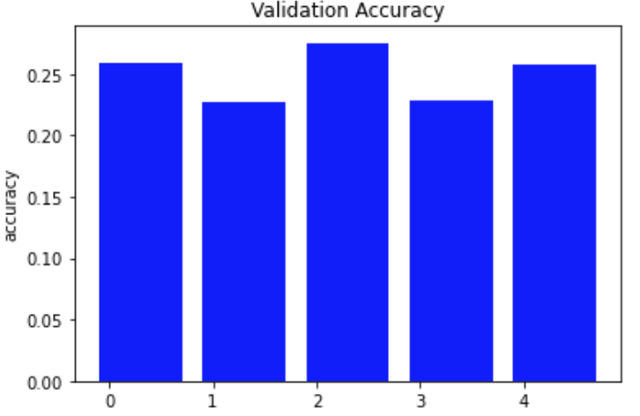
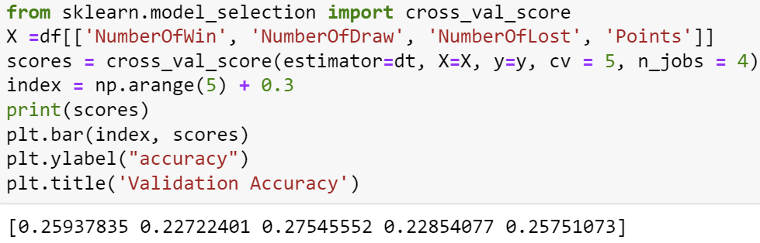
Model Validation
I validated the model using cross-validation
The validation accuracy is in around 25%, But the error between the predicted rankings and the real order of teams is maximum 5 or less!

Slide 17
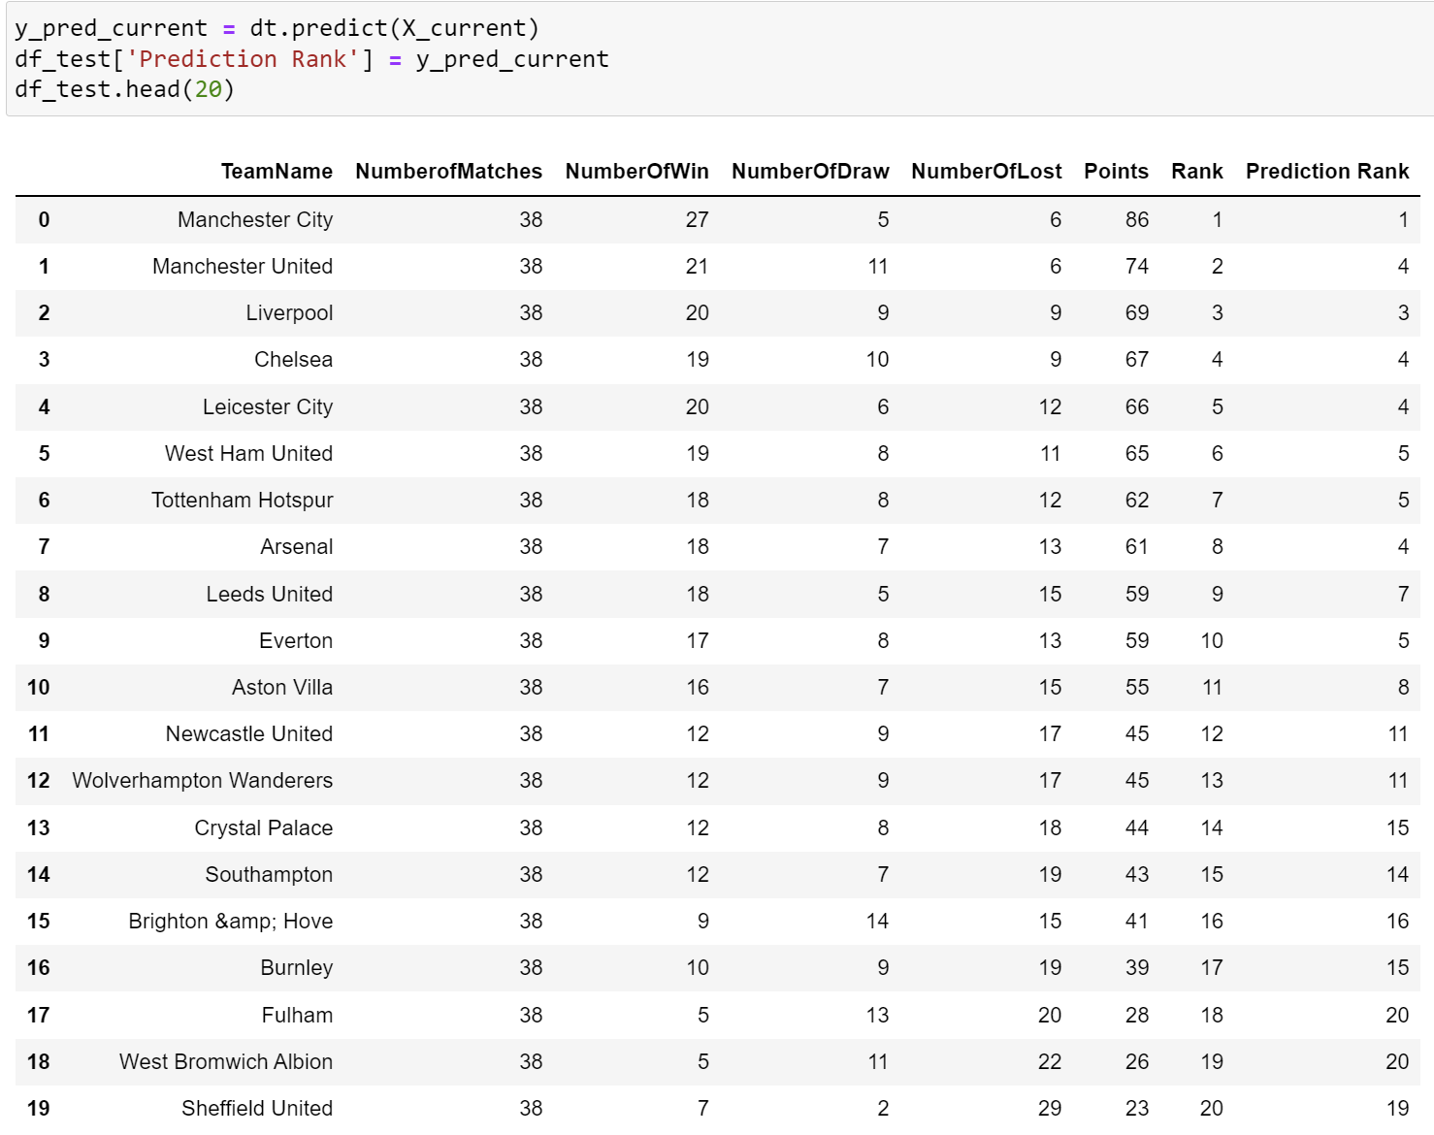
Final Results
- Model predicted successfully the that Manchester City will win the Premier League Championship
-Model predicted successfully 3 out of 4 first rankings
-Largest gap between prediction and actual ranking is 5 (only once)

Slide 18
Research Question
Can we predict in what position a team will finish the season, based on history data?
Yes, we can predict the place of given football team using the model I build in this project.

Slide 19


Summary
I successfully answered a research question by crawling relevant data about it, cleaned the data, explored it, and finally used a decision tree classifier to get results about my questioned prediction.

Slide 20
Any Questions?
GitHub - https://github.com/asafH21/DataScienceProj.git

